Slide 1
Delaware Basin Completion Optimization

Slide 2
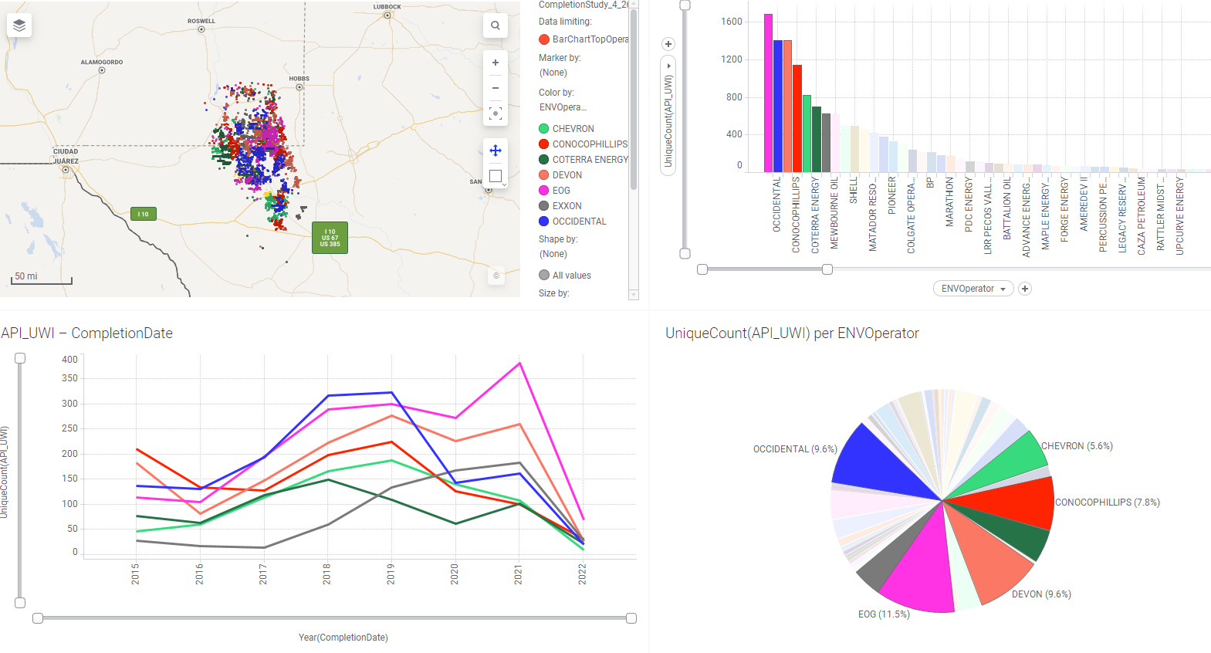
Top Operators in the Delaware Basin
Top 7 Operators account for 40% of wells since 2015
Top 7 operators cover the entire basin
Proprietary design tests to optimize completions by each company
Use public data to arrive at current optimized design by trending completion design over time

Slide 3
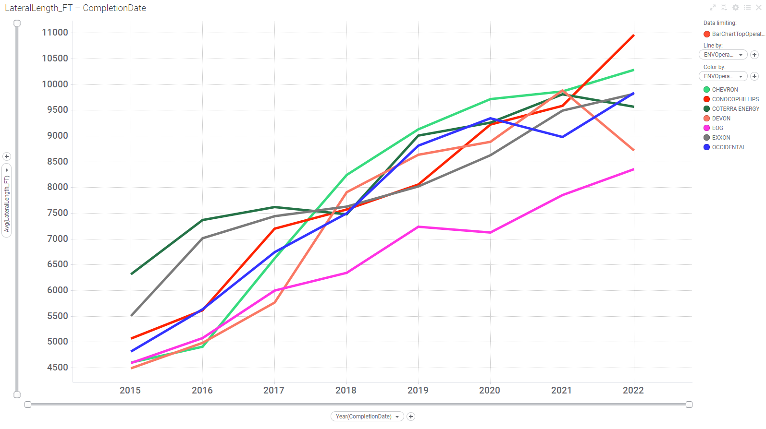
Lateral Length vs Year
Operators drilling longer wells every year.
Expect this trend to continue due to better economics.

Slide 4
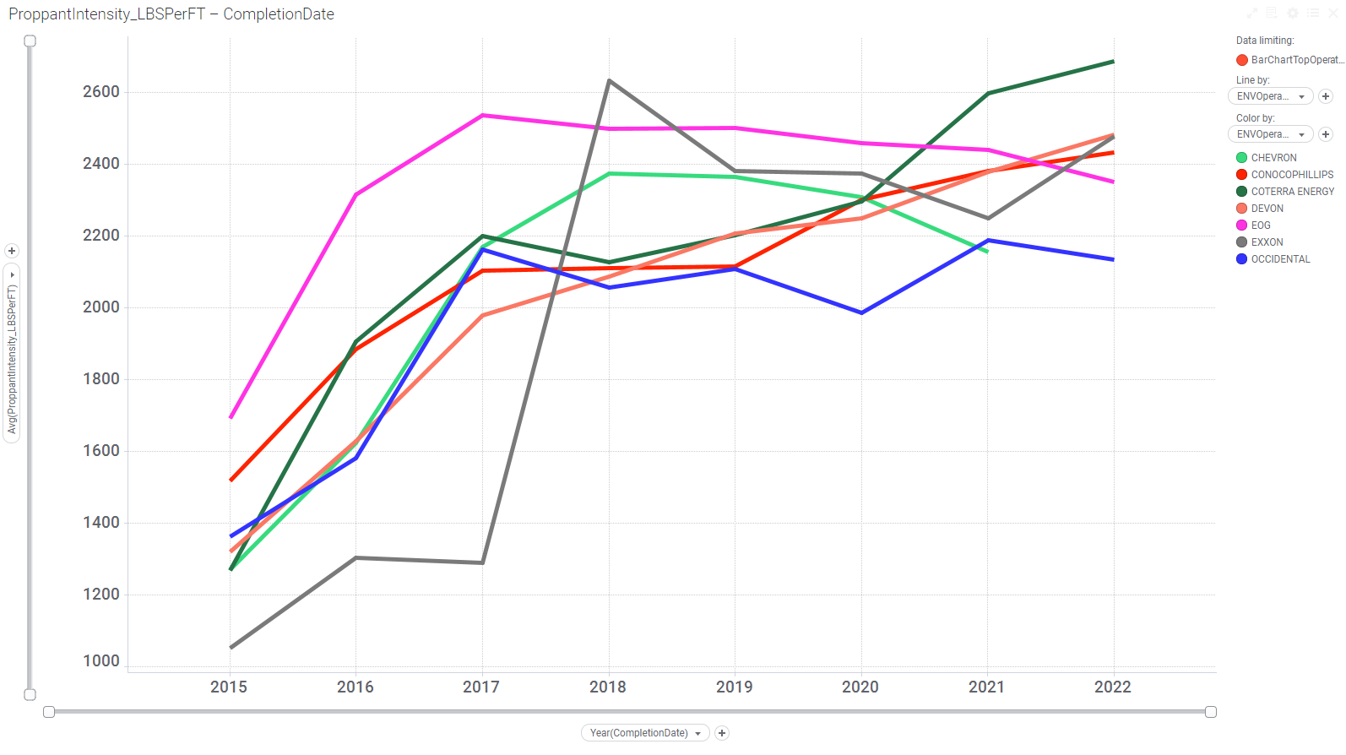
Proppant #/ft Stable since 2017
Operators appear to have optimized near 2400 #/ft designs.
Trend appears flat after 2017.

Slide 5
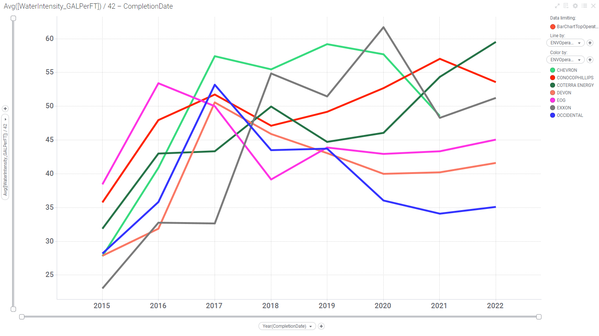
Water bbls/ft Stable since 2017
Operators appear to have optimized near 50 bbl/ft designs.
Trend appears flat to slightly decreasing after 2017 but there is spread between top operators.

Slide 6
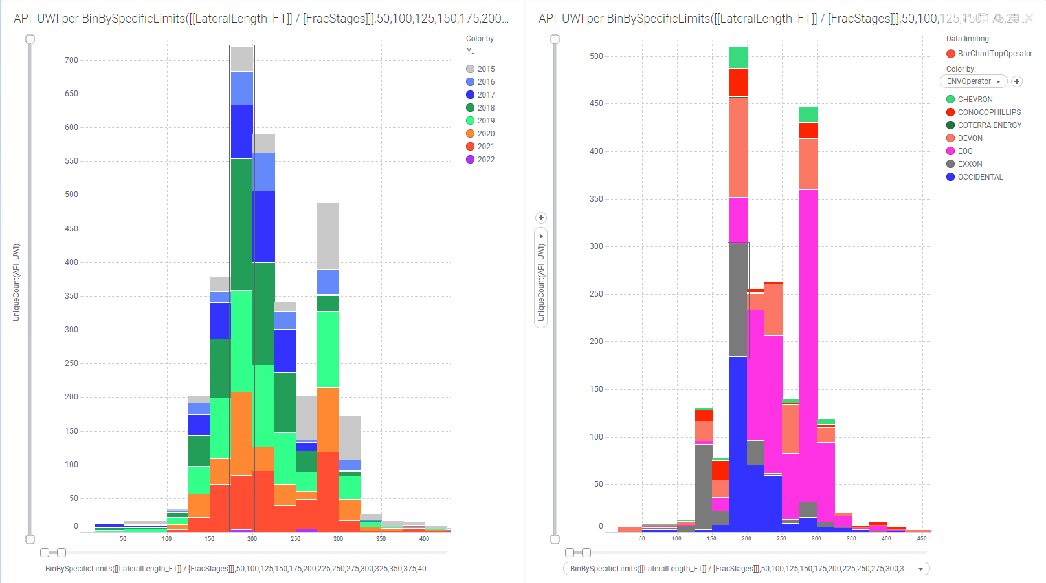
Stage Length Bi-modal
Stage length appears to have 2 camps, around 200 ft stage spacing and 300 ft stage spacing.

Slide 7
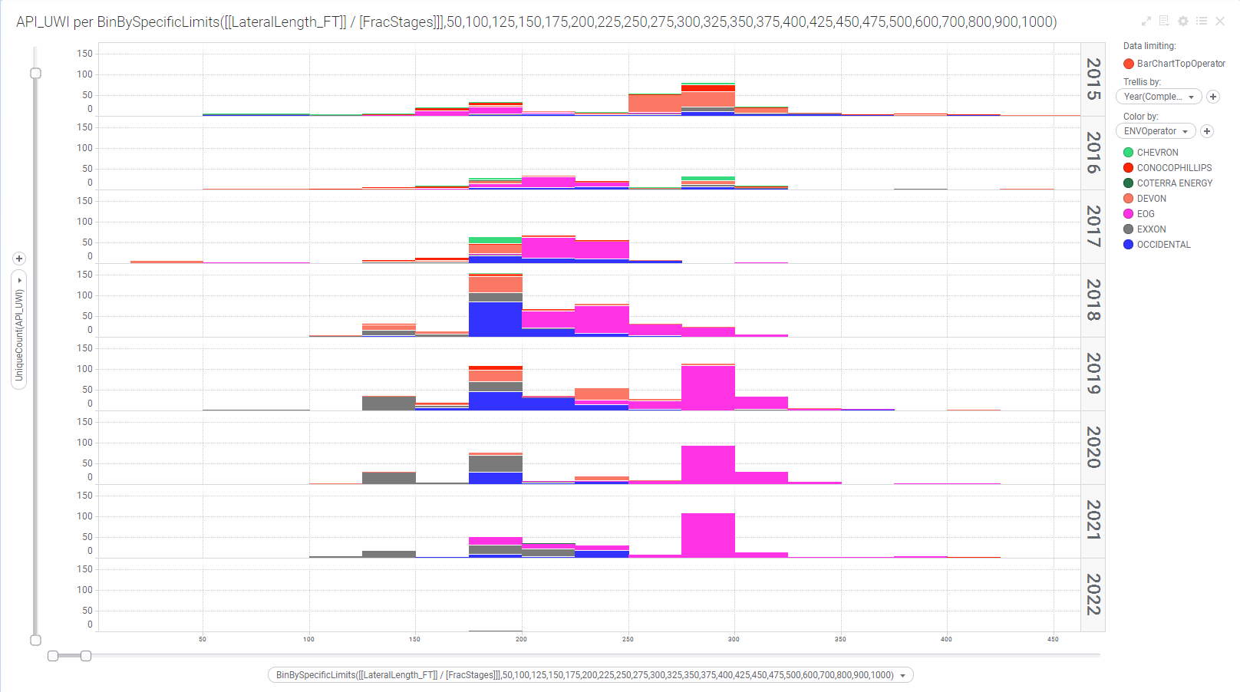
Stage Length trend over time
Trellis by year, EOG moved from 200 ft stage spacing to 300 ft stage spacing.
Longer stages save on cost if there is no reduction in well performance.

Slide 8
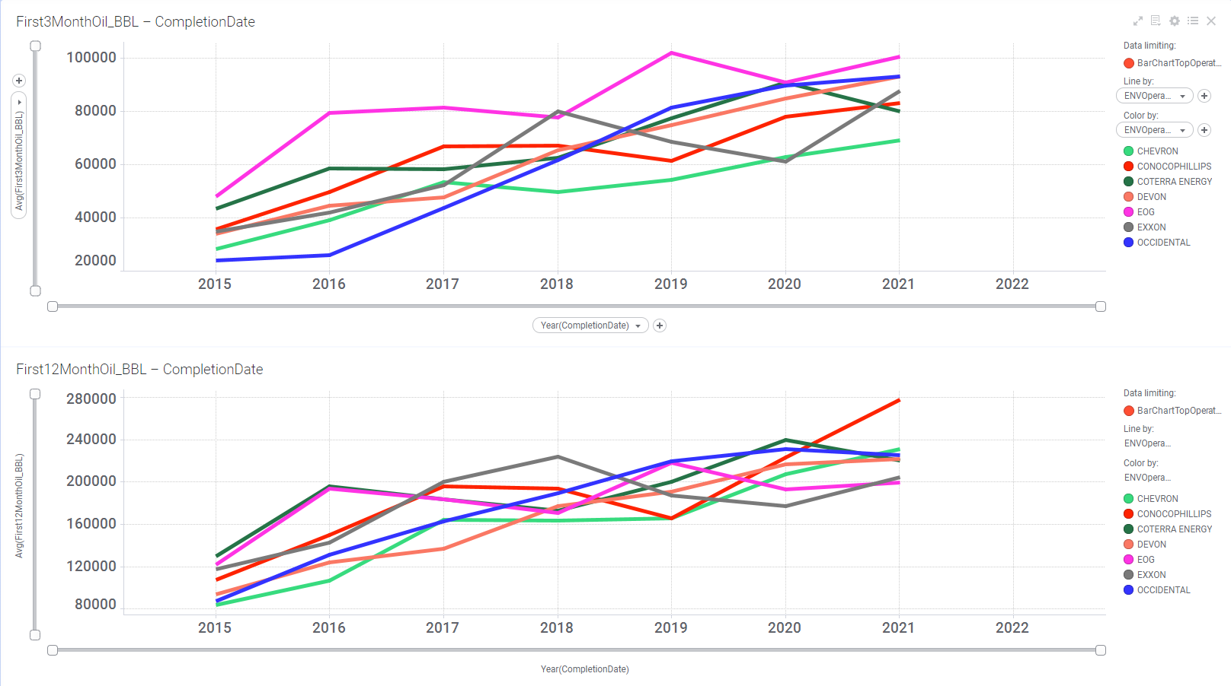
Well Performance
3 Month and 12 month oil production overtime
Production is increasing every year
Production not normalized
EOG with 300ft stage spacing appears to be the correct stage spacing.

Slide 9
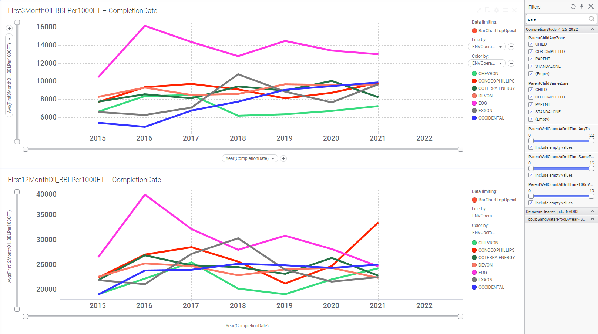
Well Performance Normalized
3 Month and 12 month oil production overtime Normalized
Production has been flat since 2016-2017
Longer laterals have increased production.
Appears completion design approached an optimum with current technology
EOG with 300ft stage spacing appears to be the correct stage spacing

Slide 10
Summary
The top operators in the Delaware Basin account for ~40% of all wells completed since 2015.
The completion trend overtime appears the designs have optimized from 1400#/ft and 35 bbls/ft in 2015 to 2400#/ft and 50 bbls/ft in 2022.
Rising well production since 2017 is attributed mainly to longer laterals.
Completion design basically flat since 2017.
EOG has the best 3 and 12 month oil production, indicates 300ft stage spacing saved on well cost and does not reduce well performance.

